Slide 1

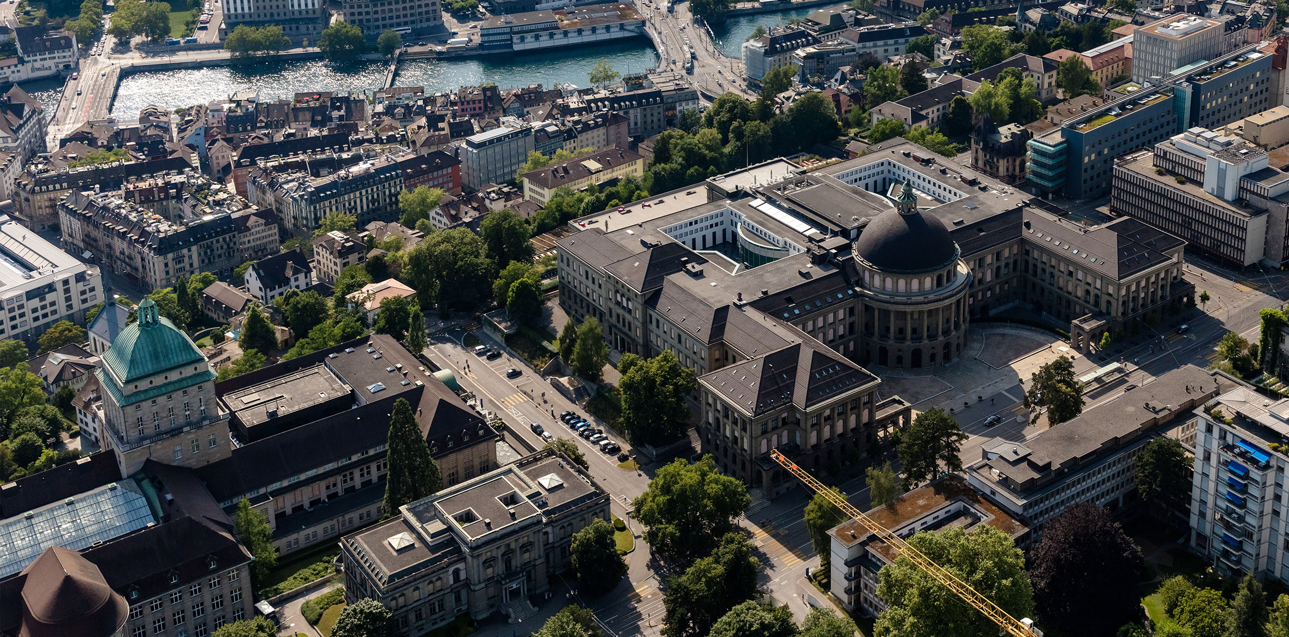
Split-as-a-Pro: behavioral control via operator splitting methods
Yu Tang
31 October 2024
Supervisors:
Alberto Padoan
Carlo Cenedese
Alessio Rimoldi
John Lygeros
Notes:
QA: 1. Prove of convergence
2. Constraints that are not easy to project
3.
In this project, we develop a new control framework under behaxxx

Slide 2

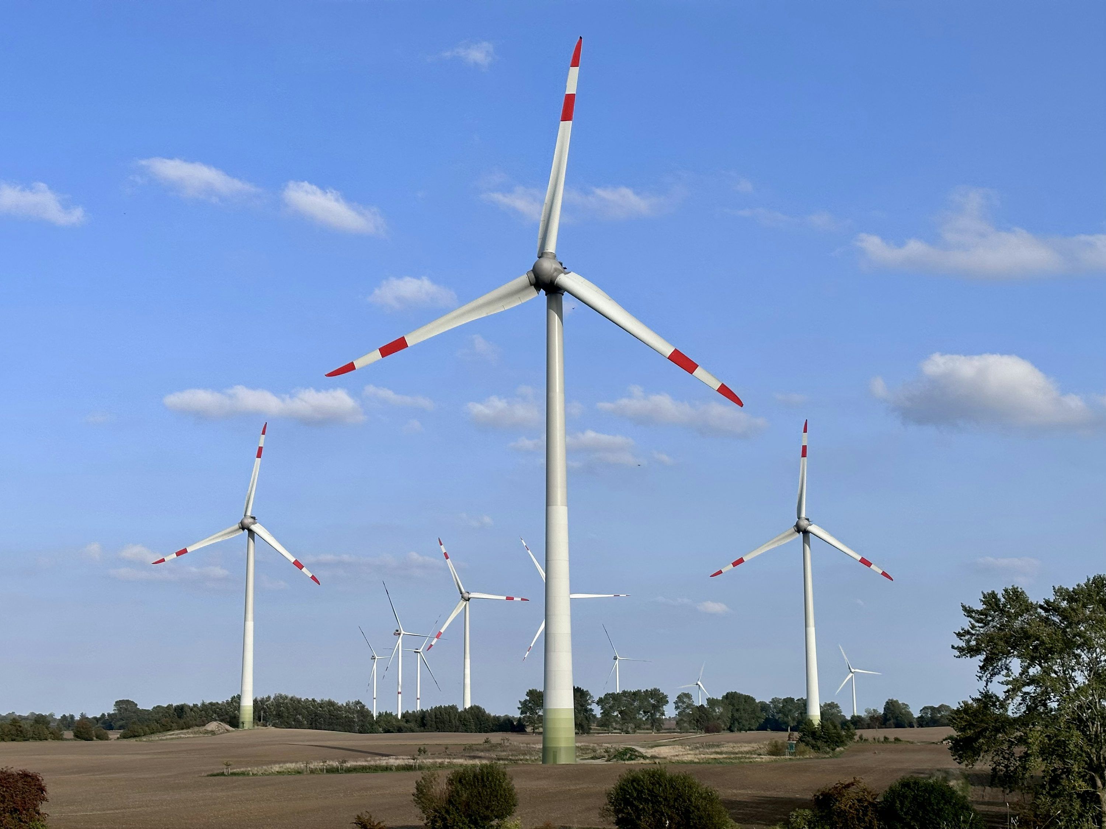

Large-scale interconnected systems !
Notes:
Motivation is that in academia or industry, controlling large-scale system is still a hot and challenging topic

Slide 3
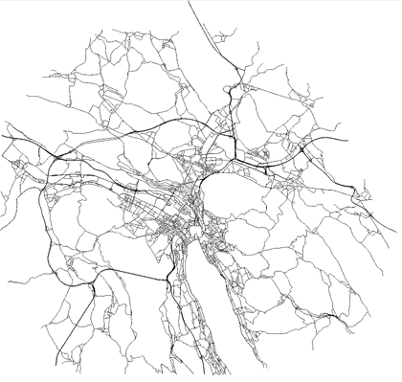
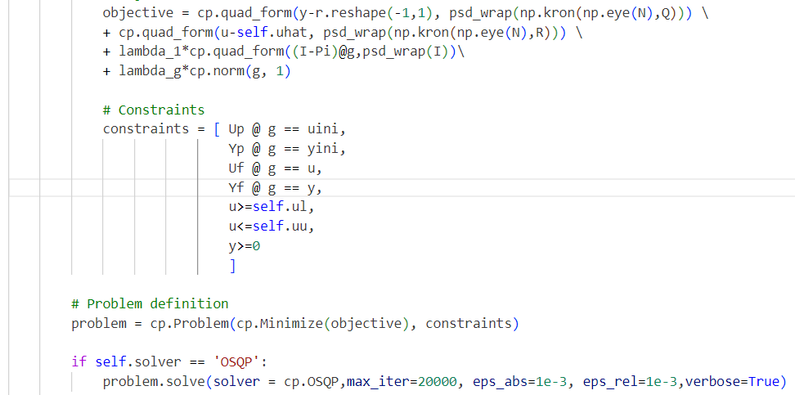
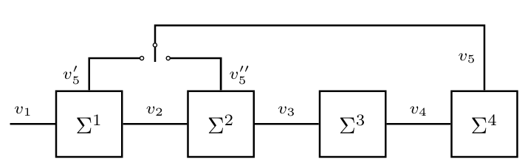
Traffic control via DeePC with Quadratic Programming (QP) solver
`
Big QP problem
Computational costly !
Leverage interconnection structure !
Notes:
My project is under the group of unjam where we want to solve traffic congestion problem in Zurich. So far, a common method we use is by data-driven control on it. Problem: good control performance but solve the optimization problem for the entire network
Treat each region as a subsystem, Each single subsystem has its own behavior, leverage the graph structure
Splitting and scalable alternating Projection (Split-as-a-Pro)

Slide 4
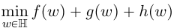

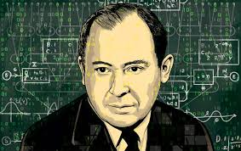
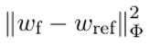
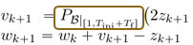

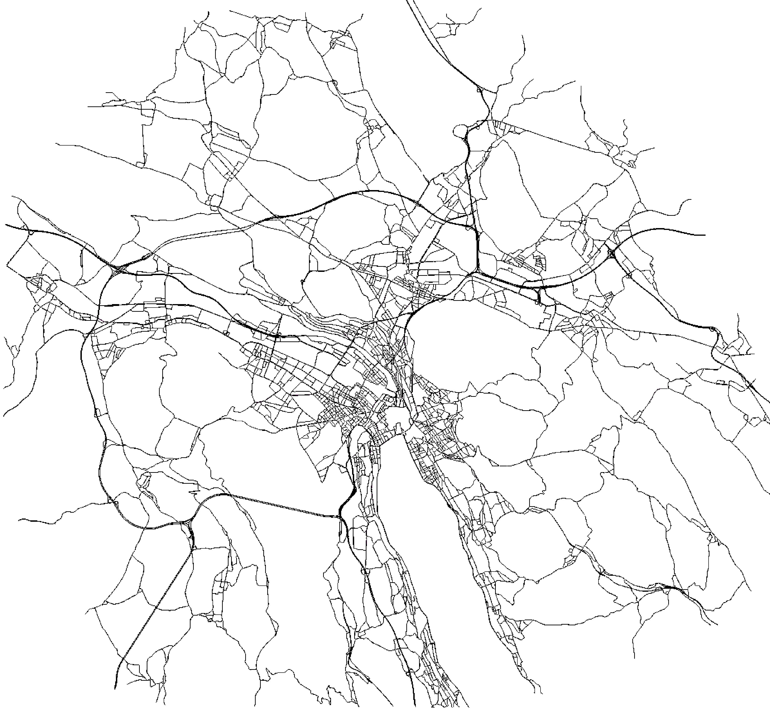
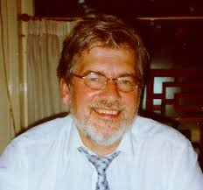
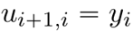
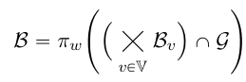

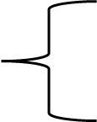
Take-home message
wref
DeePC
wini
wf
B|[1,T]
V.S.
Leverage interconnection architecture
Distributed control framework
(LQT-Split-as-a-Pro)
Apply operator splitting methods
Employ alternating projections
Notes:
Explicitly leverage the interconnection structure
von neumann
J.C Willems
For the system modelling part:
We explicitly model the ..
For the controller part:
Decompose a problem into several subproblems that are easier to solve, by operat
The ultimate goal is to solve a real-world large-scale control problem in a much quicker way. But as the project goes, we find out there are many theoretical work and simulations that are meaningful to be done before jumpting into the practical implementation. So, this work and the presentation shall be a bit theoretical. Apologize for that but I will try to explain it clearly.

Slide 5
Agenda
Preliminary
Behavioral linear quadratic tracking via operator splitting
Distributed behavior control
Numerical simulation
Conclusion

Slide 6
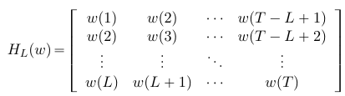
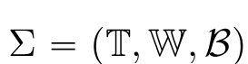
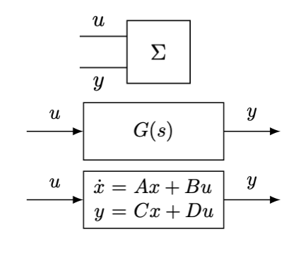
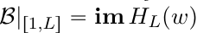
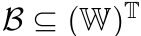
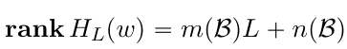
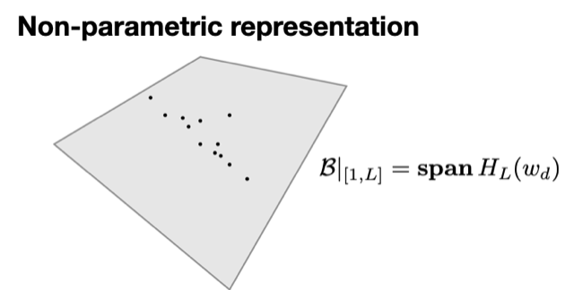
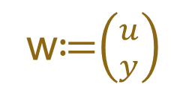
Preliminary
Data-driven representation
wini
wf
B|[1,T]
A behavior space containing all admissible trajectories of a system
w≔$\left({u \atop y}\right)$
Notes:
Model a dynamical system as a tuple
Contains the space of all admissible trajectories a system can generate
Subset of the signal space over the time axis.
A commonly used data-driven representation is by constructing hankel matrix from input-output trajectories, there is so called fundamental lemma
We can collect the data of a system from given inputs and form a Hankel matrix of depth L ,associated with the sequence w

Slide 7
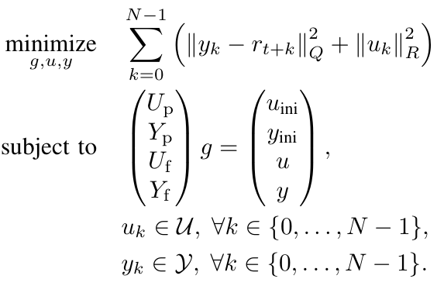
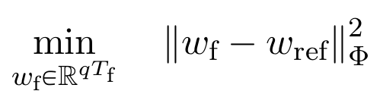
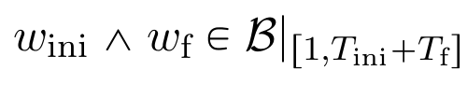
Preliminary
wref
DeePC
wini
wf
B|[1,T]
Notes:
direct predictive control, no regularizaiton, no noise
Solve the linear quadratic control problem in a receding horizon fashion
The ultimate goal is to solve real-world large scale problems, but as the project goes, we found there are many meaningful theroretical work and simulations to be done before. Ao this presentation shall be a bit theoretical.

Slide 8
Split-as-a-Pro
Operator Splitting and scalable alternating Projections
wref
wini
wf
B|[1,T]
operator splitting
alternating projections
behavioral interconnections
Notes:
The ultimate goal is to solve real-world large scale problems, but as the project goes, we found there are many meaningful theroretical work and simulations to be done before. Ao this presentation shall be a bit theoretical.
New framework: split-as-a-pro
There are three main ingradients: 1. decompose an optimization problem and apply operator splitting methods
2. Later you will see the bottleneck of the algorithm is a projection step, which can be efficiently computed by alternating projections algorithms
3. Cause we explicitly leverage the behavioral interconnections, we ara able to formulate a distributed algorithm, that leads to scalability

Slide 9
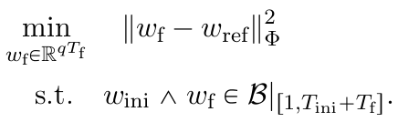


Behavioral linear quadratic tracking via operator splitting
wref
Problem formulation
wini
wf
B|[1,T]
Lifting
Operator splitting
f(w) + g(w) + h(w)
Notes:
Simple LQT problem
We increase the dimension of the variable, replacing the constraints by introducing two indicator functions.
dimension of w is the same as the dimension of (wini,wf)
And we can show there is one-to-one correspondence between the optimal solutions of the top one and the bottom one by the map Pi_f. if the top problem has a unique solution, the bottom one also has a corresponding unique solution.

Slide 10
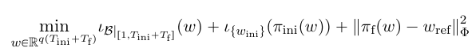

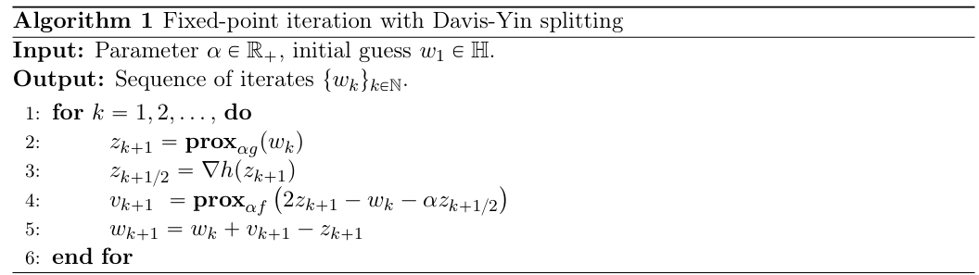
Behavioral linear quadratic tracking via operator splitting
wref
Operator splitting
wini
wf
B|[1,T]
2-operator（e.g., forward-backward splitting, Douglas-Rachford splitting, ADMM）
Operator splitting methods
3-operator（e.g., Davis-Yin splitting, forward-reflected-Douglas-Rachford splitting）
4-operator（e.g., Backward-Semi-Forward-Reflected-Backward splitting）
https://arxiv.org/abs/1504.01032
Notes:
where f, g, and h are proper, closed, and convex functions and h is Lipschitz di erentiable.
Fixed point iteration. It will converge upon some conditions(convex,smoothness conditions) on the functions and the parameter alpha. In general, our problem formulations satisfy those conditions.

Slide 11
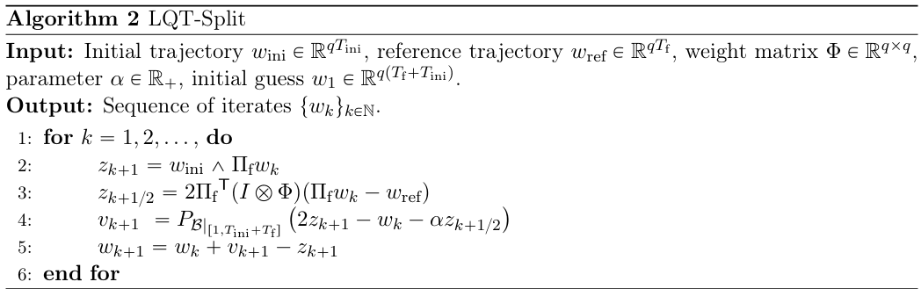
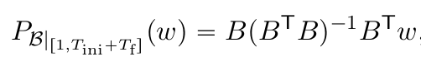
Behavioral linear quadratic tracking via operator splitting
wref
Centralized algorithm - LQT-Split
wini
wf
B|[1,T]
Projection on the behavioral subspace of the entire system
Interconnection structure?
Notes:
We are able to prove the convergence to the global optimum of this algorithm, which I wouldn’t discuss due to time constraints
So far, everything still centralized and we haven’t utilized the graph structure. The tricky point is here
computing that projection can be take long for large-scale systems, e.g., if m = 100, L= 100, then rank H ~ 10^4
Luckily, we have work from JC.wi, who introduces the way to leverage interconnection structure.

Slide 12
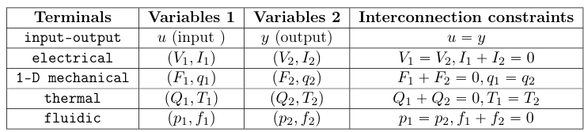
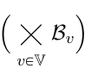

Distributed behavior control
Leverage interconnections structure
B1
B2
B3
B4
Network as a “virtual” system
B1
B2
B3
∩
B4
Notes:
The behavior of any interconnected system can be treated as the intersection of two behavior spaces.
behavior spaces of 4 independent subsystems, intersect with/(“plug into”) the network behavior
The network behavior G requires us to know the graph structure and the interconnection constraints beforehand.

Slide 13
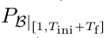
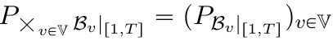
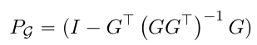
Distributed behavior control
Distributed projections
x0
Alternating Projection
Computational costly !
Alternating Projection
B1
B2
B3
B4
Notes:
Instead of direct projection which is the bottleneck of the centralized algorithm

Slide 14
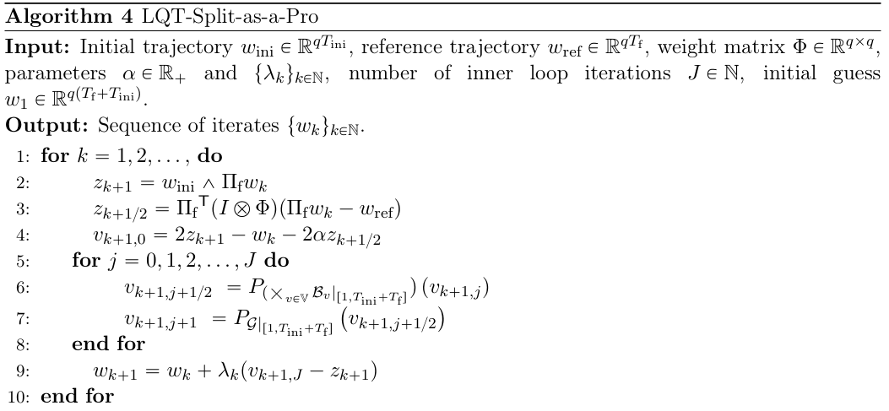
Distributed behavior control
B1
B2
B3
Distributed algorithm - LQT-Split-as-a-Pro
B4
Parallelization
Notes:
Because these subsystems are already isolated
Simply split a vector, project onto each individual subspace, and then stack the vector back again. Because each subsystem is isolated.
It works well under the assumption that each individual subsystem has a behavior space whose dimension is much smaller compared to the entire system space.

Slide 15
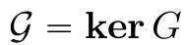
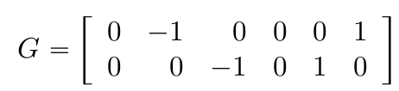
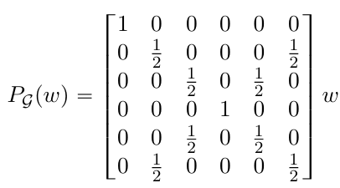
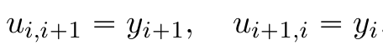
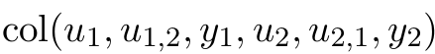
Distributed behavior control
Projection on the network behavior
Network behavior via kernel representation
y1=u2,1
B1
B2
y2=u1,2
u1
u2
Manifest variable
Averaging consensus matrix
Notes:
Single input single output, in total 6 variables
Kernel representation : matrix G such that all trajectories/manifest variables of this system lies within the nullspace of G.
All about the theoretical parts, lets see some numerical simulations

Slide 16
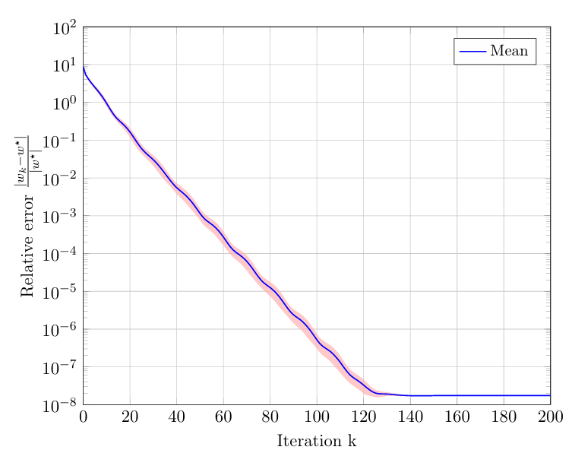
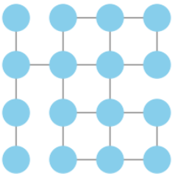
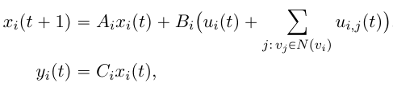

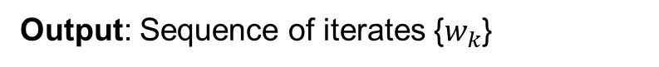
Numerical simulation
Linear convergence of Split-as-a-Pro
Output: Sequence of iterates {$w_{k}$}
$$\frac{|w_{k}−w^{∗}|}{|w^{∗}|}$$
Linear convergence
Notes:
No theoretical work/literature so far supporting the derivation of convergence rate, test empirically
Interconnected power-grid model, discrete-time linearized swing equation

Slide 17
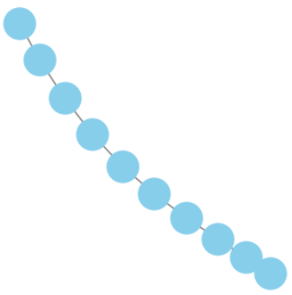
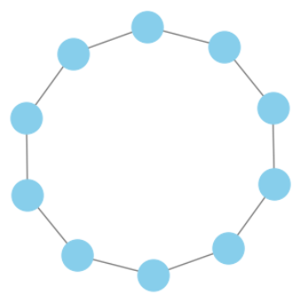
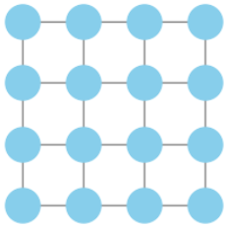
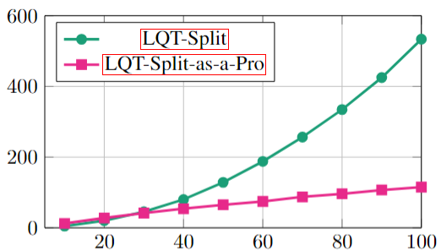


Numerical simulation
Runtime of LQT-Split and LQT-Split-as-a-Pro
Runtime (s)
No. subsystems
Notes:
Well, you may argue that this may not be the case for other complex graph topologies.

Slide 18


Numerical simulation
Graph topology and runtime
Runtime of LQT-Split-as-a-Pro is determined by the max node degree
Notes:
Indeed, assumption that the graph is fairly sparse.
(As the graph becomes more and more connected, we have to measure more and more latent variables, that makes the behavorial space become larger and larger.)
Size: 100 subsystems and randomly add edges at each epoch.
The average runtime of centralized is not influenced by the interconnection structure
top graph plots the runtime with respect to No. edges, if the graph topology is fairly sparse, it wins the centralized one

Slide 19



Numerical simulation
Control performance
Grey-box modelling using Split-as-a-Pro
Notes:
Haven’t exemplified, but can do grey-box modelling
We use hankel matrix as a representation of bahavioral space, but it doesn’t have to be. Can be model-based representation, Markovski matrix, SLS parametrization
Grey-box modelling comes for free in our framework

Slide 20


Conclusion
wref
Summary
Linear convergence of Split-as-a-Pro
Distributed algorithm outperforms for large-scale system
Runtime is influenced by the max degree of a node
(interconnection structure design, graph clustering)
Can integrate both data-driven and model-based representations (grey-box modelling)
wini
wf
B|[1,T]
Future research directions
Extend to infinite-horizon behavior and different optimization problems
Extend to nonlinear behaviors
Explore other operator splitting schemes to include regularization
Design interconnection architectures
Thank you!
Questions?
Yu Tang
yutang@student.ethz.ch
Notes:
Many thanks to Alberto for the initial proposal of this framework, and of course great thanks to Alessio and Carlo for very useful discussions of the theory, thanks to John for the review of the paper

Slide 21


Additional Slides : D-Y splitting and inexact D-Y splitting

Slide 22





Additional Slides : Convergence of Split-as-a-Pro

